Slide 1
Homo Atmaki
A 2-D sidescroller + interactive text narrative

Slide 2
Concept
_________________________________________________________________
This is a story of becoming.
Homo Atmaki follows the tale of two siblings, the last of the Homo Atmaki, who set out into an unknown world, learning about themselves and what it means to be human.
Every day they travel the wondrous and hostile environment,and their interactions with each other and the environment around them (social and natural), reveal to them more about their humanity.
Notes:
Slice of life genre

Slide 3
Concept Reinforced
_________________________________________________________________
Core
Side-scroller gameplay with keyboard/mouse mechanics
Narrative progression (Dialogue, Campfire)
“Directives”
Day: Storytelling
Campfire: Pacing
Notes:
By day, they travel, overcoming obstacles in the terrain, and understanding themselves and each other through their decisions and actions.
Narrative progressed through “directives”, which are sort of like quests, that reveal the game world and progress the narrative. The narrative is focused mainly on character growth.
It’s grounded in interactive fiction, with the side-scroller being used to flavor and pace the progression of the story.

Slide 4
Chimeras, Clones, and Lost Species
Game world: “Avatar” style makeover of dystopian Earth (James Cameron, Avatar)
We follow the story of two Atmaki siblings, a seven-year old brother, and his three-year old sister, as they escape the destruction of their home. A wave of paralysis slowly but surely weaves its way across town, the Atmaki passing on the messages of “I can’t move” and “Run” through their hands, a sequence of elegant hand expressions passing through the town like a fire line, until it reaches a stiffened mother’s hands as she tells her children to “Go (We are Over).” (Sign Language)
Notes:
This makeover includes remnants of genetic engineering in flora and fauna, but it’s not saturated, the way Fallout is. The ecosystem is reverting back, with these new additions to the environment dying out. But some wonders still dot the land.
(Atmaki siblings…) The Atmaki are a relative of Homo Sapiens, who speak briskly, but move elegantly, like dancers. They communicate emotion through sign language. Anyway, these siblings are escaping (the destruction of their home, and our narrative focuses on the process of adjusting that the siblings have to go through, no home, parents are dead, and they barely know what the world is like outside their village.

Slide 5

Insert cloak picture and silhouette of siblings
“Wrapping his sister in his father’s cloak, and grabbing his mask, we follow the journey of these siblings, last of their species, as they make their way into this now-uncharted world.”
Notes:
The Atmaki normally wear black sleeveless cloaks to highlight the expressions of their hands. The brother wears his mask and cloak at all times, after the “escape”. The sister is more normal for now (no mask), but may develop her own quirks later on. We’ll see.

Slide 6
Character Growth
Initially, the sister is still too young to process the “death” of their parents, at least not in the traumatic way that the brother does. He has to heal from that incident, learn how to face the unknown world, and be responsible for his sister.
The sister is shaken, but still curious about the world; her joy and brashness are a contrast to the reserved and solemn nature of the brother.
Notes:
If we have enough time, I’d like a character arc for the brother, then a fast-forward, into the character arc for the sister.
Otherwise, a vague, “sticking together”, staying strong, experiencing brief moments of joy, kinda vibe works too I guess.

Slide 7
Visual Style
Abstract art style like that shown in Journey, if Journey was 2-D.
It would be nice to collate the style of Journey, which is like rigged-model abstract, with a more simple Mario-style abstract, style. Having an abstract style, means you can move between different levels of abstraction in the imagery, creating a more immersive narrative. (Campfire scene could be Mario style)
Game World:
Level design for the background environment
Less is more.
We could possibly treat the whole background as a rigged model, and maybe do some interesting animation through code.
I want mainly a black-and-white color scheme, with color where appropriate.
Notes:
I think that because an abstract style allows you to subtract a lot of detail, making sure that what’s left is still immersive and eye-catching is important. Therefore… we want (level design). I want the lines and shapes to draw the eye, sort of like photography angles. The idea here though, is that (less is more.) So… It’s fine if some of the background elements are so abstracted, that they’re just filled and colored polygons. In some places where we want to bring focus to the characters, a lot of the environment can be just silhouetted.

Slide 8
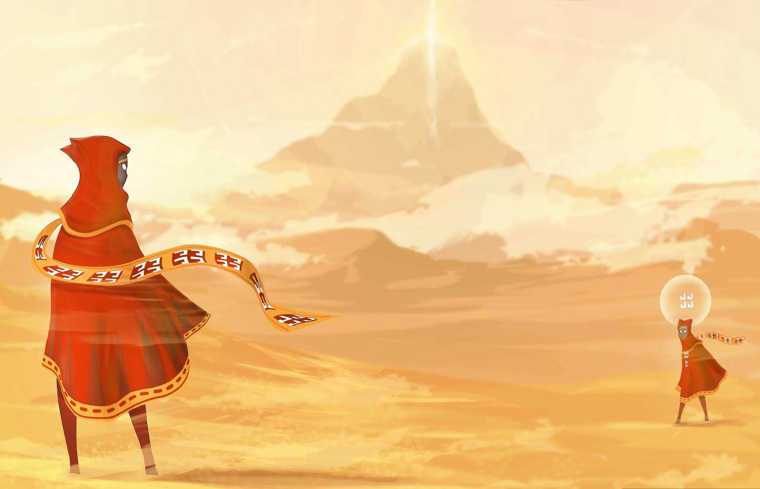
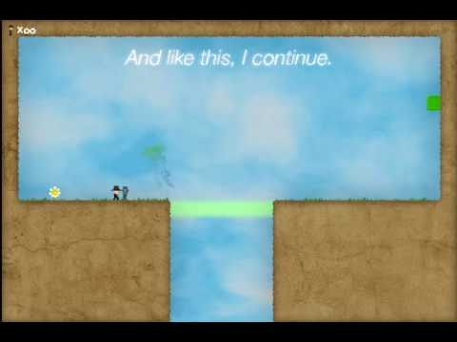

Slide 9
Visual Style
Character(s):
-The character style should also be abstract, but it can be more detailed than the environment.
-Ideally, it would be nice for the character to have some personality animation (through movement), beyond basic movement animation frames. Using a rigged-model for the animation can make this doable.
(Ex: huddling, shivering, puffing up in pride, etc.)
-Complexity of character detail = complexity of animation
Notes:
(...complexity of animation)
If animating the hands is too difficult, there doesn’t have to be fingers, etc.

Slide 10
Mechanics
Primary mechanics revolve around terrain traversal
Interactive mechanics being: offering a foothold with hands, or leaning over a ledge, hands reaching down, etc.
Different environment and obstacles have different effects on movement ability/interaction.
Inputs: WASD and mouse.
Notes:
Keyboard Buttons: Left-right, up-down movement buttons in side-scroller. The buttons can mean different things, if there is complex environment interaction, like crouching behind a bush. Left-right for linear chat progression.
Mouse-driven: Dialogue wheel/list for dialogue selection (Maybe, probably not). Point-and-click for environmental interaction
Inventory as a flavor feature, to “actualize” important narrative elements like sentimental belongings

Slide 11
Audio Style
____________________________________________________________________________________
Sound scale that features sounds of nature,
Some thematic instrumental, based on narrative context, maybe some character themes.
Elements of the “sound scale” should fade in and out depending on multiple factors such as environmental context, geographical level progression, narrative progression, etc.
Notes:
If possible, for the thematic instrumental songs, I want to the sound artists to create a sound/melody that they like as a “palette”, and permutate it into a few different versions that cater to the constraints of narrative experience. If these versions can blend in with the natural sound scale, that would be even better.

Slide 12
Scope
10-minute playable demo.
1-2 minutes of Interactive Text/Visual “Cutscenes”
~8 minutes of side-scroller gameplay featuring movement and game world interaction
1 Nature “sound scale”,
1 thematic instrumental, with a core melody, interpreted into 2-3 different versions (high energy, staccato, etc. depends on the narrative)
1 narrative chapter, showing growth of main characters (1-2 pages of dialogue interspersed through the demo)

Slide 13
Pitch Development Status
The written content + speaker notes translates to like a 10 minute pitch, which is way too long. But now all the material is there, so I’m figuring out what to cut down.
I know I need more pictures, but finding what I want online is tough, so I’m drawing some right now. Ex. next slide has a draft closing picture.

Slide 14
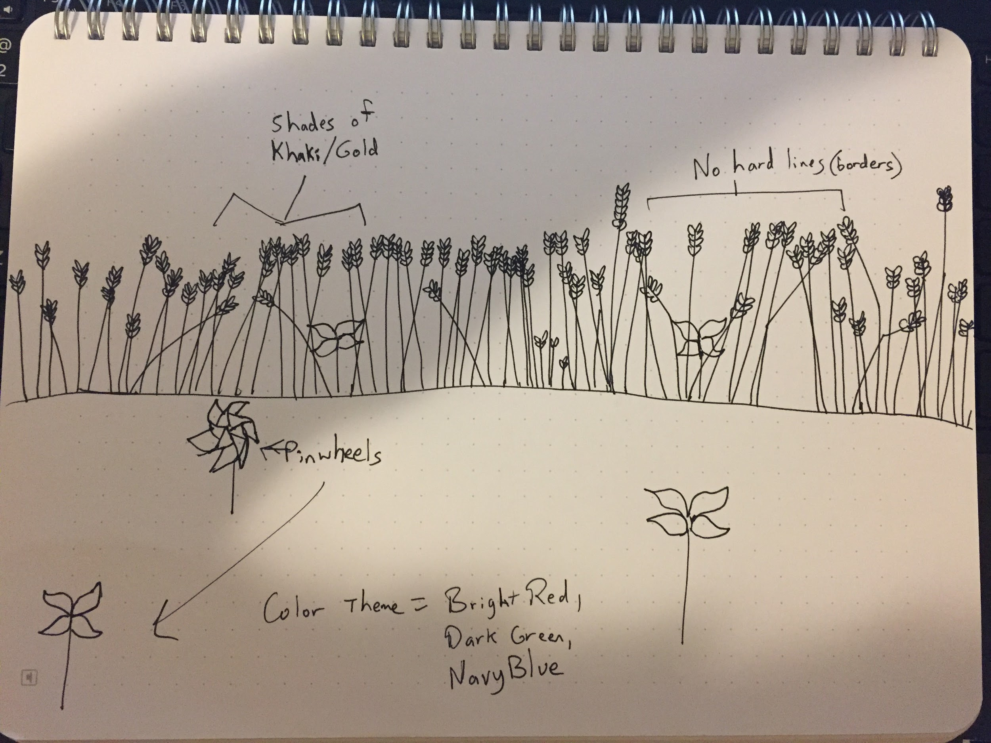
This is a story of becoming… _

